Slide 1
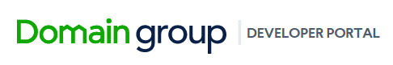
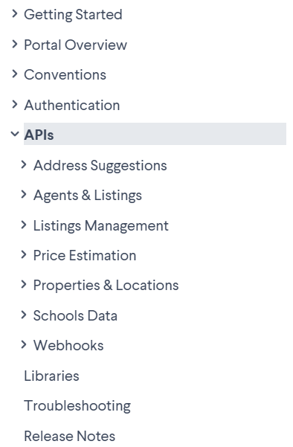
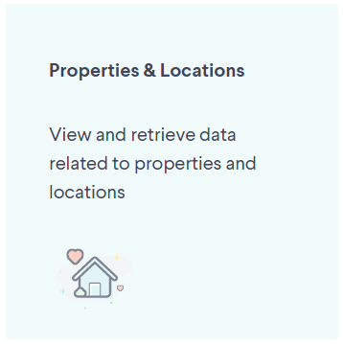
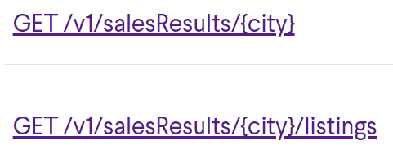
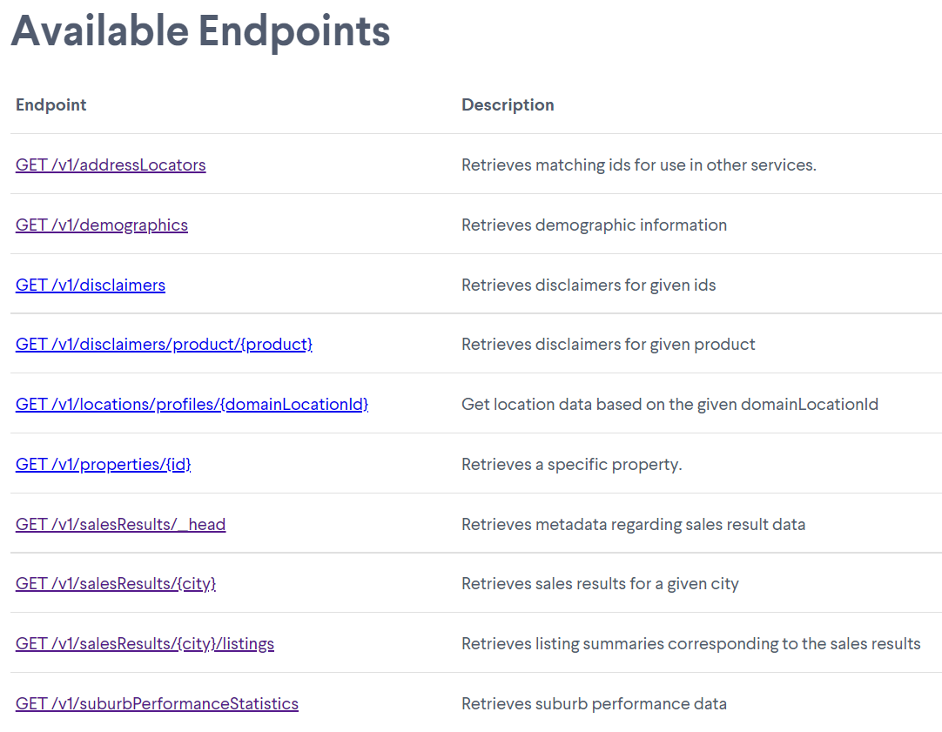
We chose to use these:

Slide 2
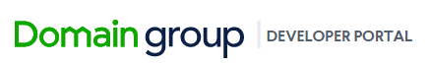
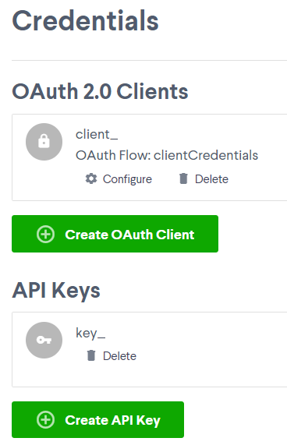
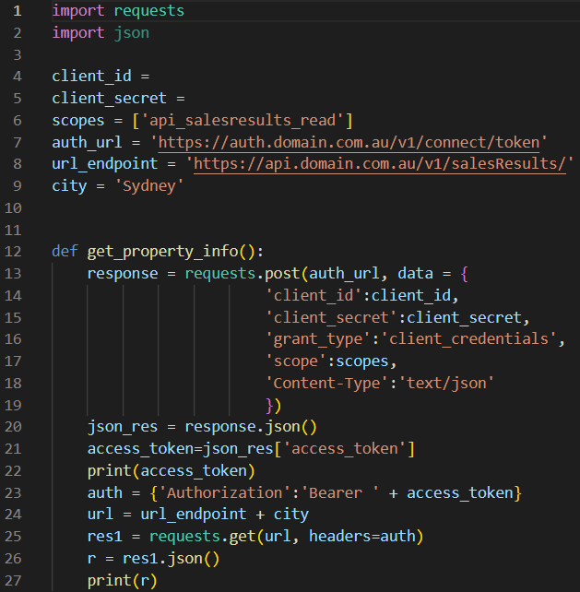
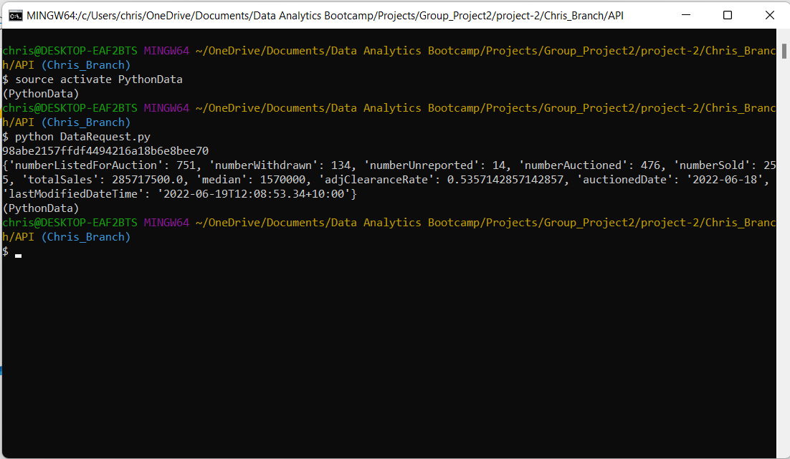
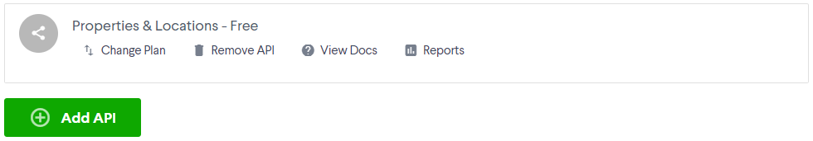
Running the ‘DataRequest’
code in GitBash:
JSON data

Slide 3
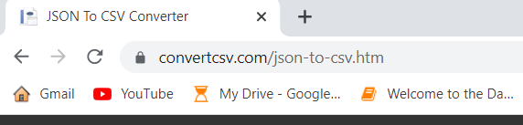
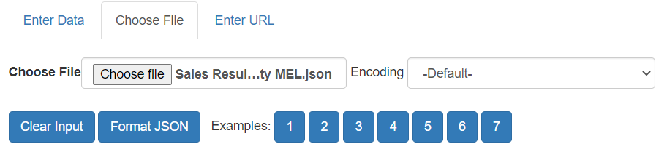
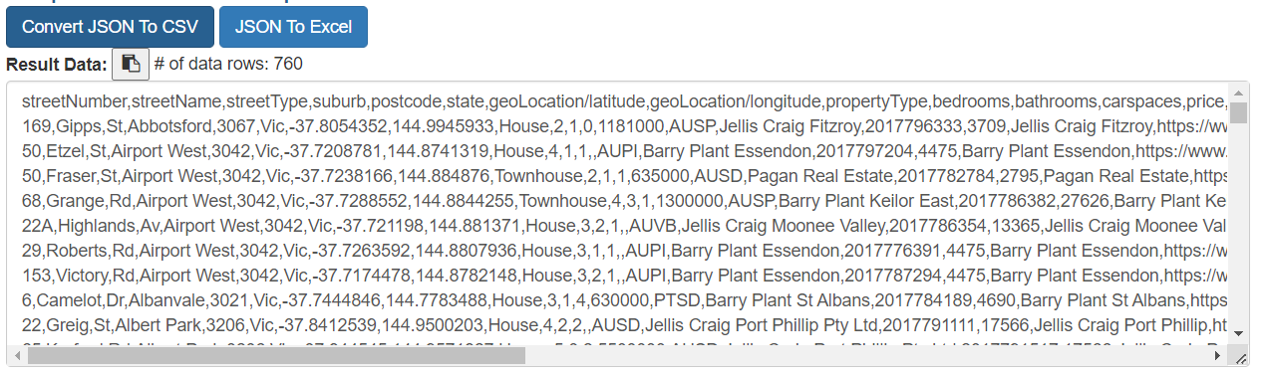
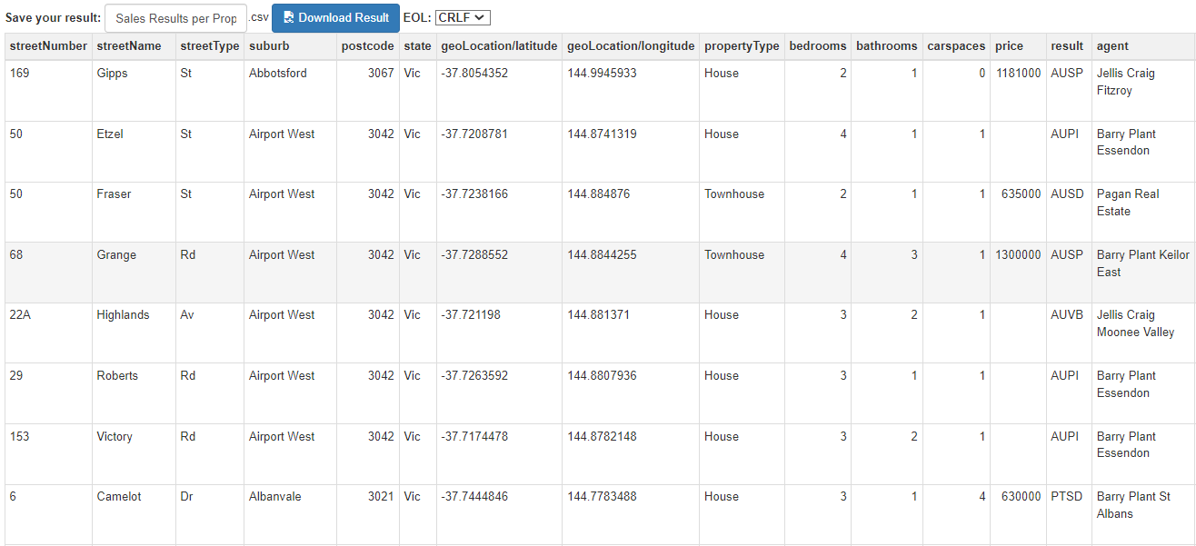
The website above enabled us to convert JSON data from the Domain.com APIs to CSV format.
This conversion enabled the data transfer to Mongo DB.

Slide 4

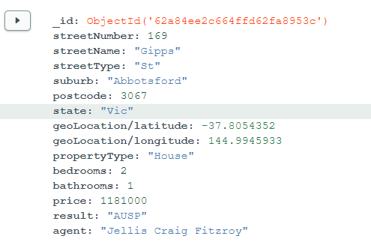
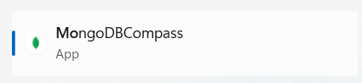
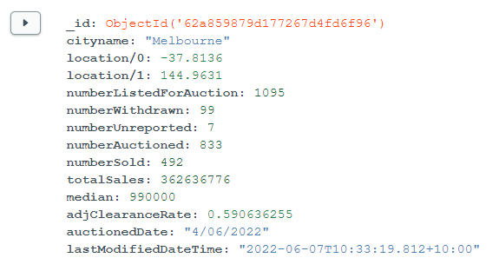
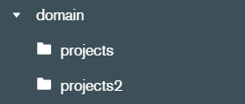
projects
projects2
Our project required the use of 5 databases in total.

Slide 5
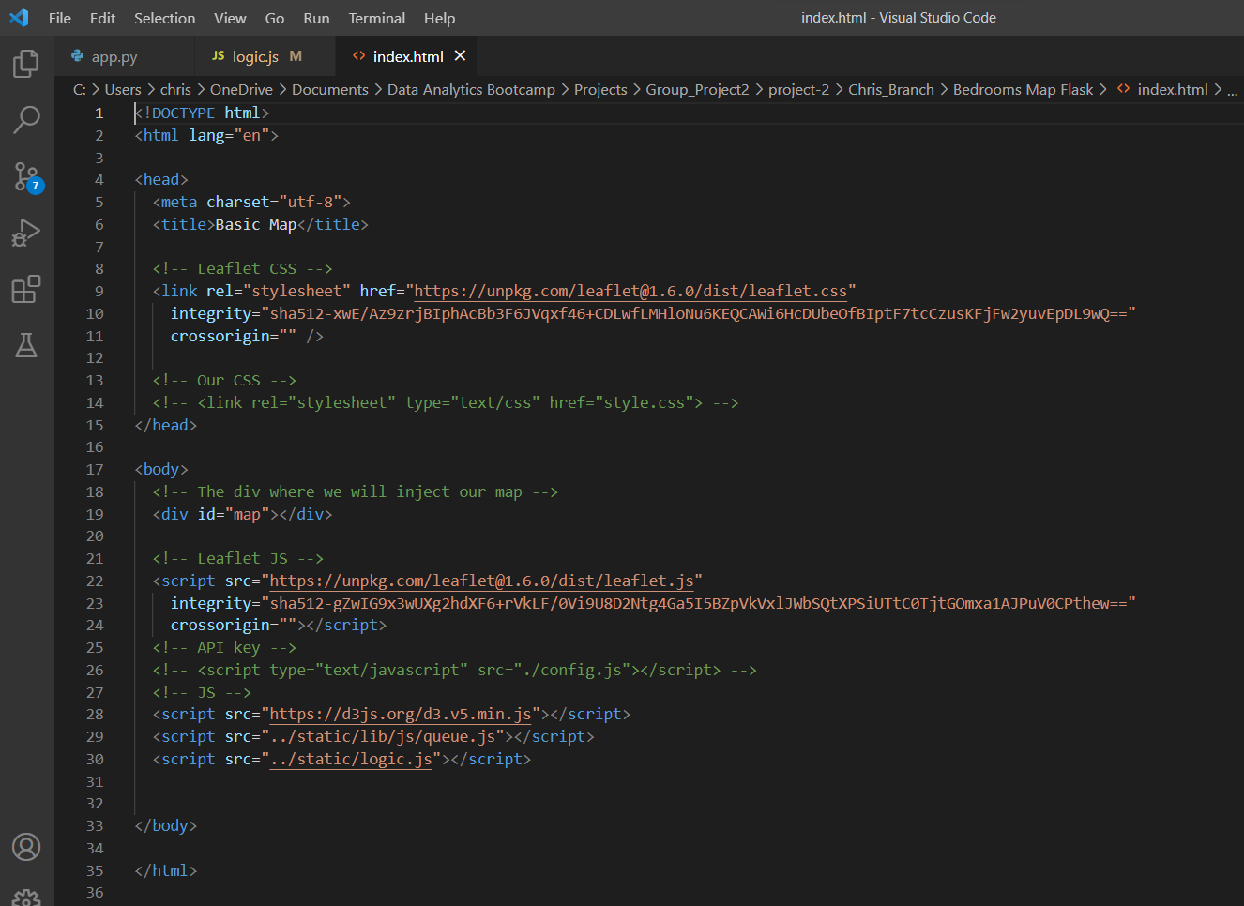
Creating an Interactive Web-Based Visualisation:
Step 1 : Create an html file
Reference the relevant ‘style’ packages.
Create a division to house the visualisation.
Make links to scripts including config and logic files.

Slide 6
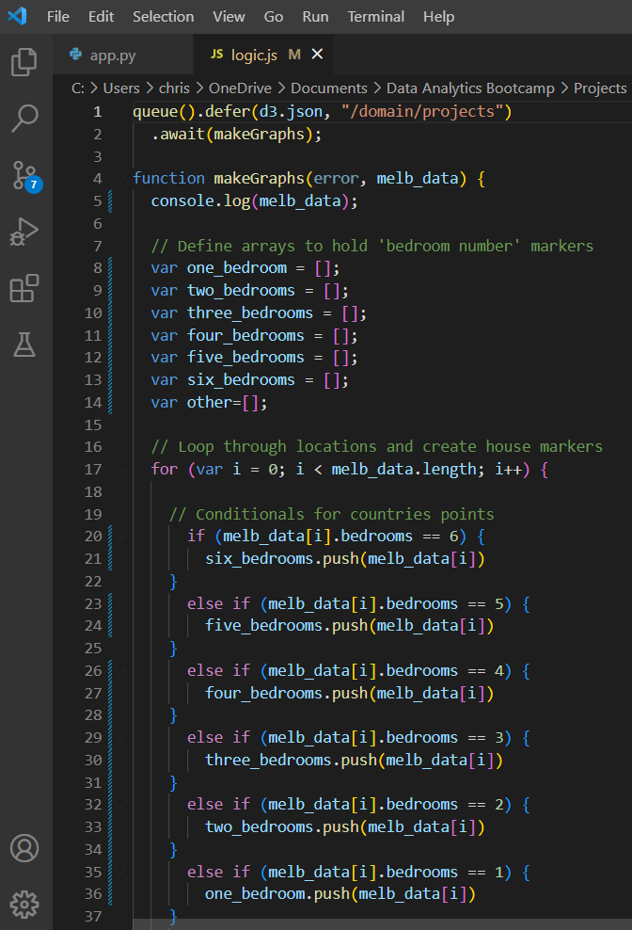
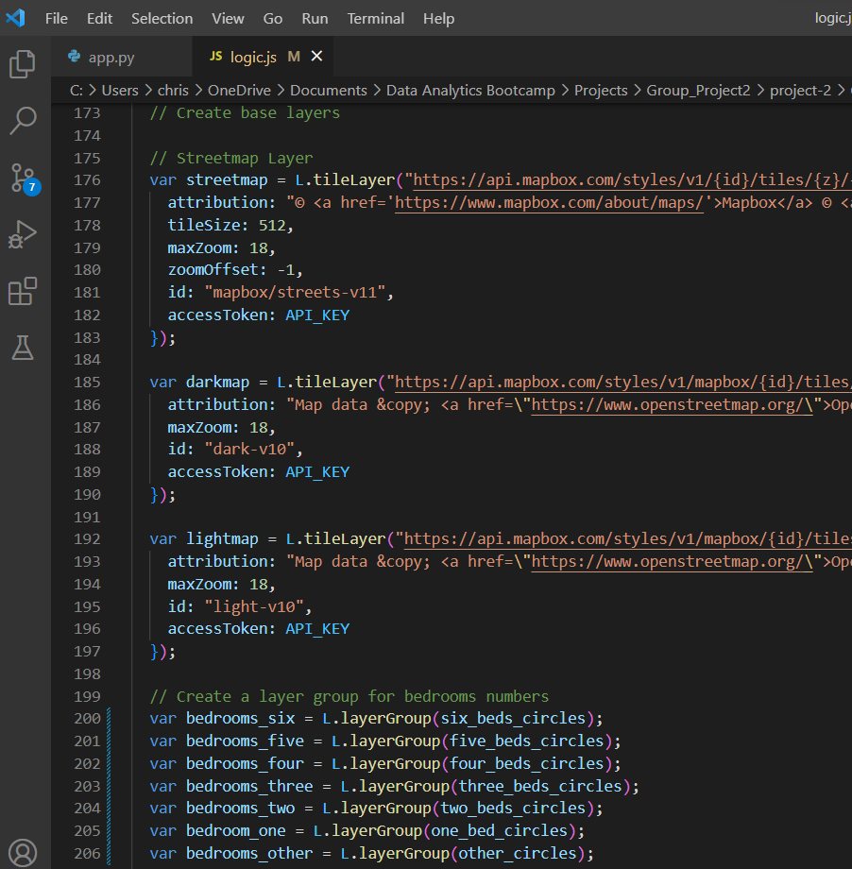
Creating an Interactive Web-Based Visualisation:
Step 2 : Create a JavaScript file
Import Mongo DB data
Create a function which build a map
Build map layers
Build marker layers

Slide 7
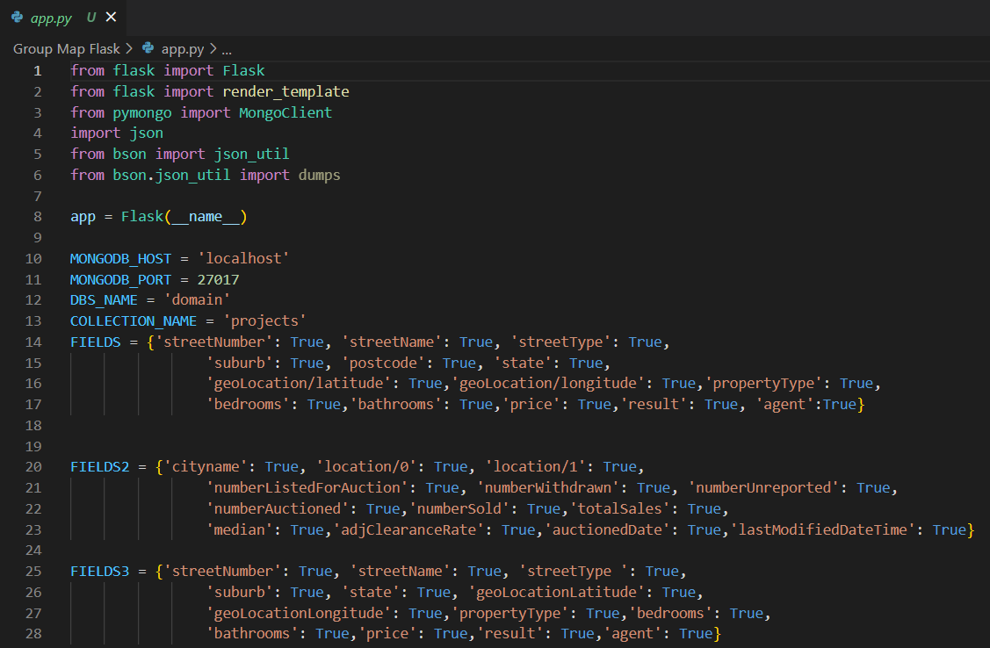
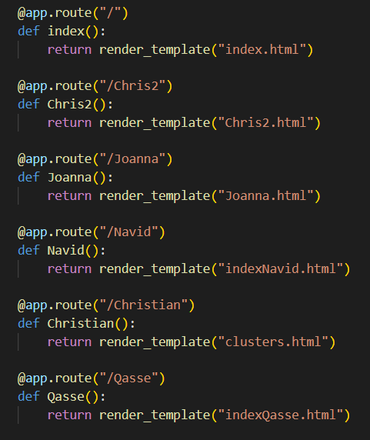
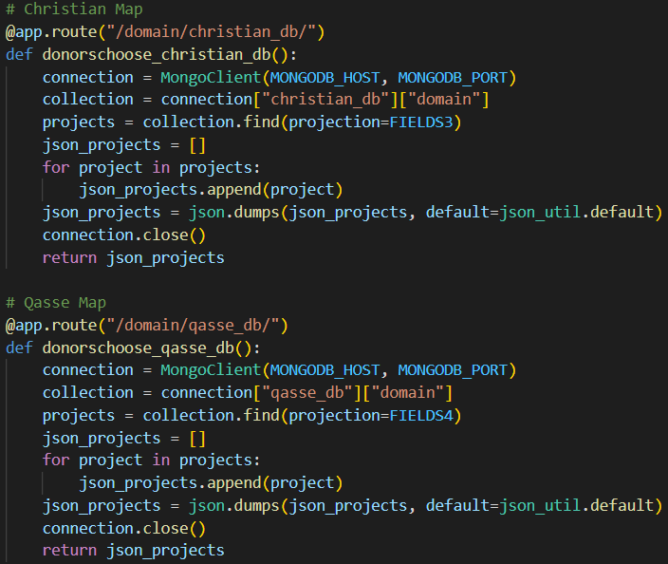
Creating an Interactive Web-Based Visualisation:
Step 3 : Create an app.py file which runs your visualisation (and others)
Create a connection to the Mongo database.
Create ‘landing page’ code which runs the index.html file when the app is launched.
Other routes that the user can explore on the Flask app.

Slide 8
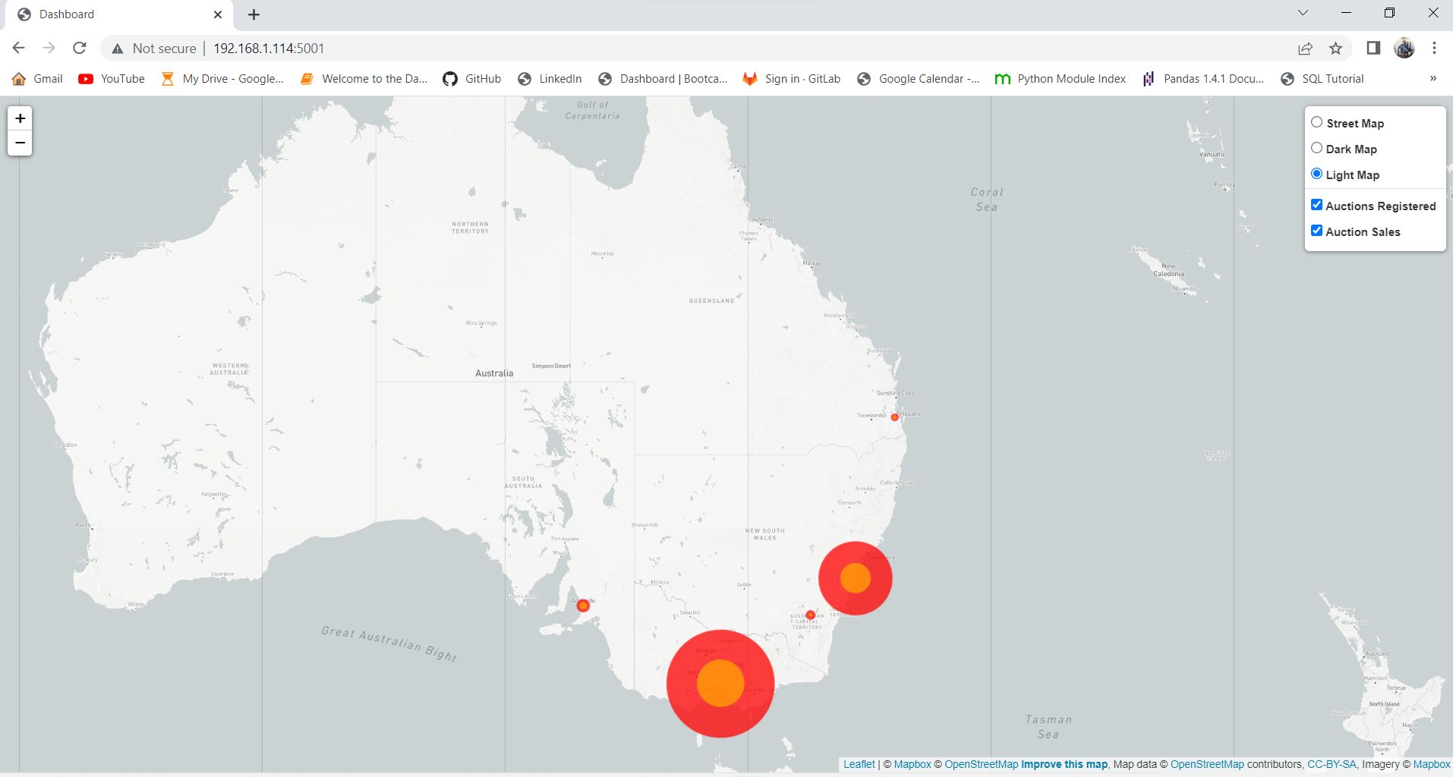
Visualisation 1:
Auction Clearance Rate Results – Eastern Seaboard Data
Hypotheses:
With the recent cooling in the housing marker we will observe a large discrepancy between auction numbers and sales in all major cities.
The effect will be felt largest in cities where housing prices are highest.

Slide 9
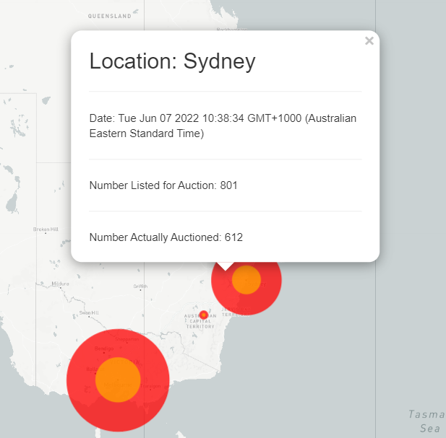
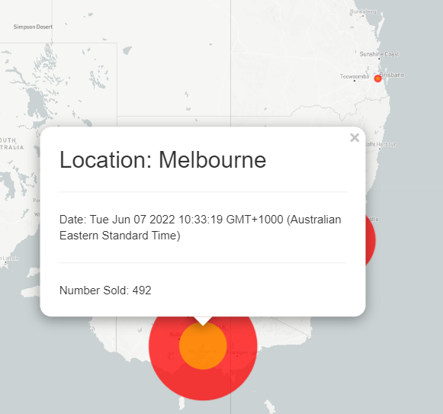
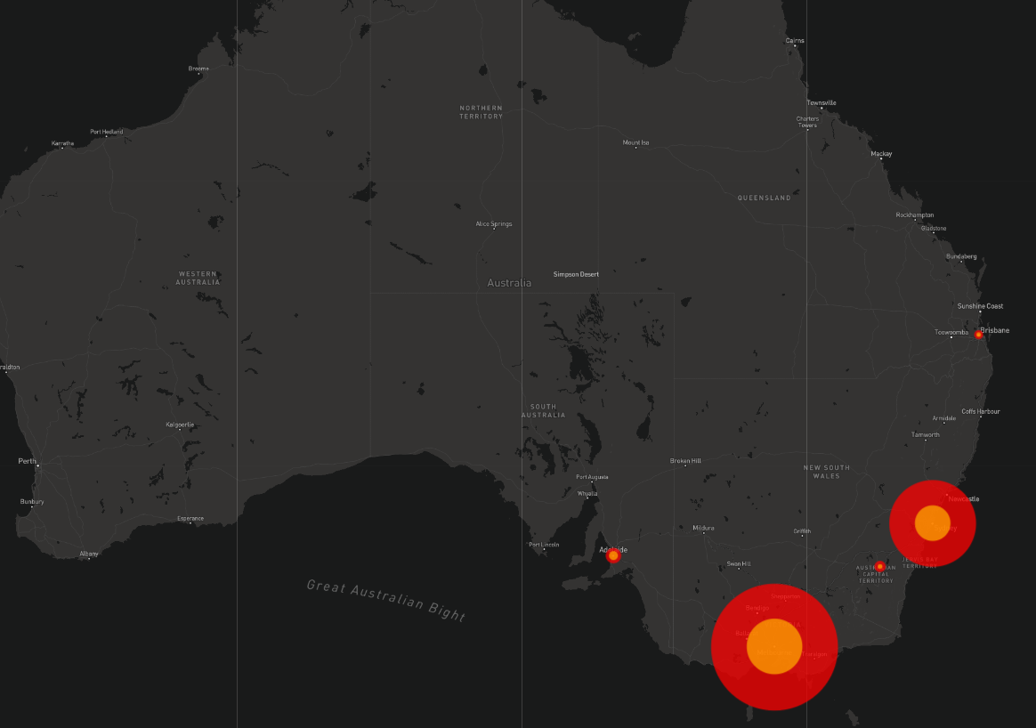
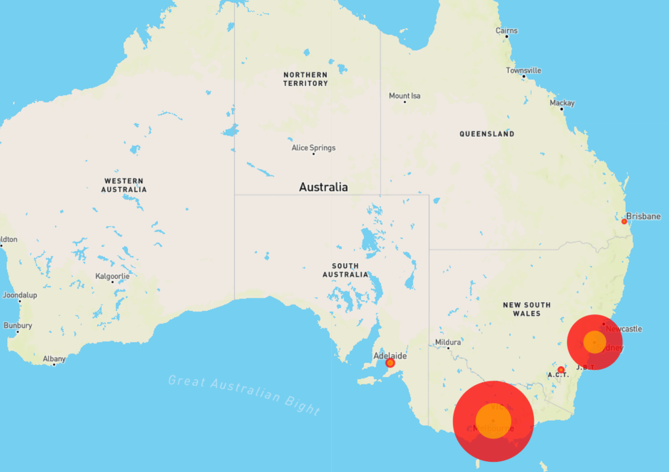
Visualisation 1:
Auction Clearance Rate Results – Eastern Seaboard Data
Outer Circle Pop-Up:
Inner Circle Pop-Up:
Dark Map:
Street Map:

Slide 10

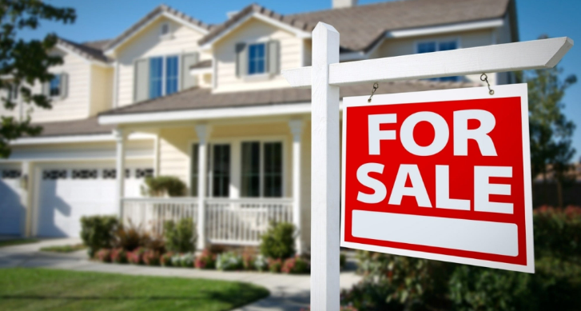
Visualisation 1:
Auction Clearance Rate Results – Eastern Seaboard Data
Findings:
Clearance Rates:
Brisbane 41% Sydney 41%
Canberra 46% Melbourne 45%
Adelaide 55%
All of the major cities on the Eastern Seaboard of Australia returned similarly poor clearance rate results.
The less expensive markets such as Brisbane, Canberra and Adelaide were not consistently higher or lower than their more expensive counterparts.

Slide 11
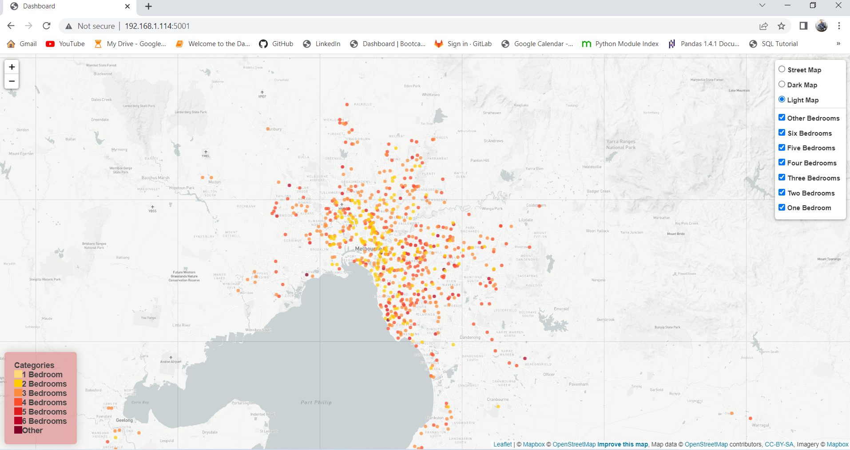
Visualisation 2:
Bedroom Numbers in Properties Sold in Melbourne
Hypotheses:
Sub-divisions of land, unit block developments and the construction of townhouses and duplexes have become increasingly popular over the last decade.
These trends will mean that the majority of homes with 1 – 3 bedrooms will be close to the CBD whilst those with 4 – 6 bedrooms will be in the middle to outer suburbs.

Slide 12
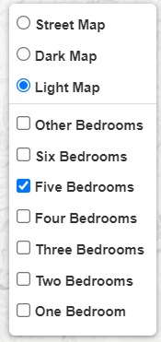
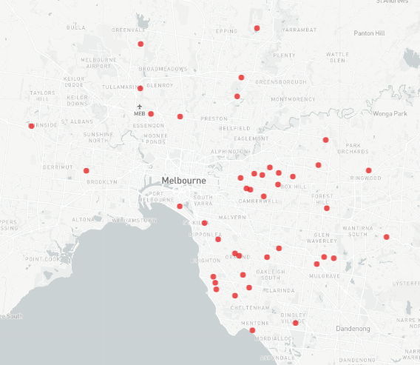
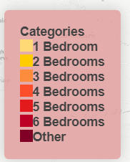
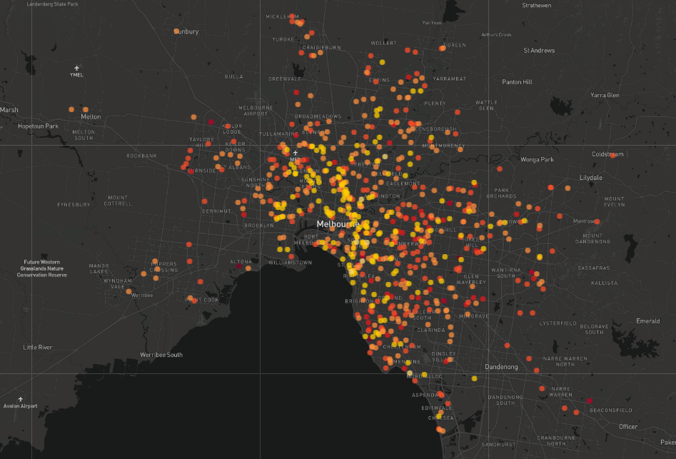
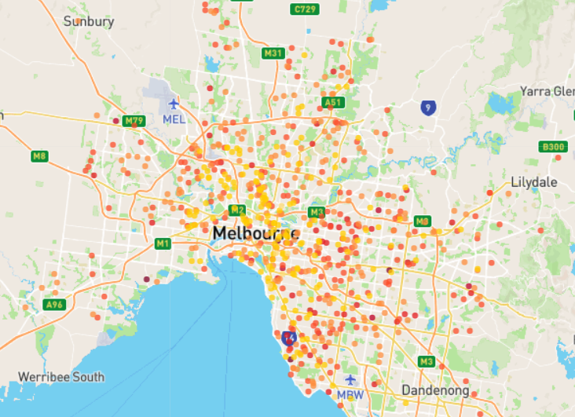
Visualisation 2:
Bedroom Numbers in Properties Sold in Melbourne
Bedroom Numbers on individual layers:
Legend:
Dark Map:
Street Map:

Slide 13
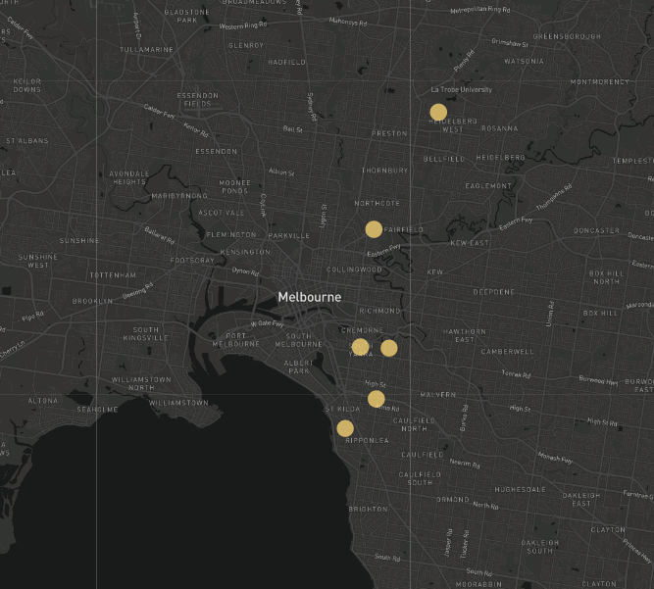
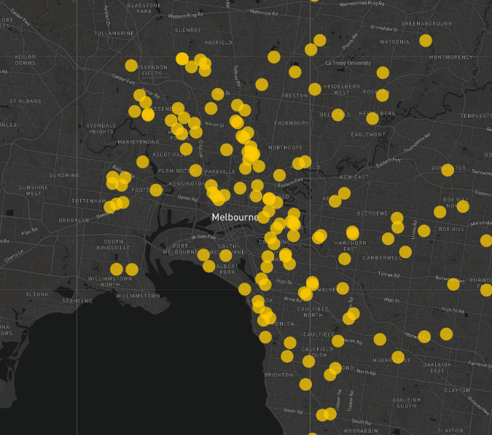
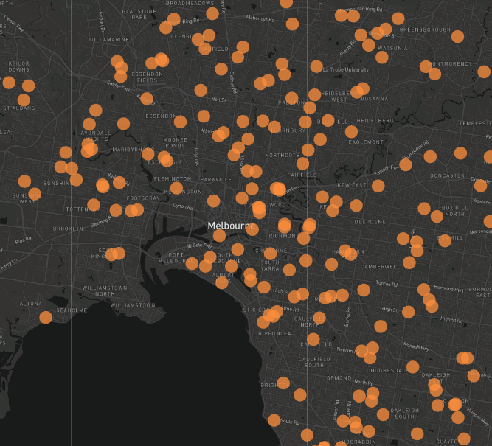
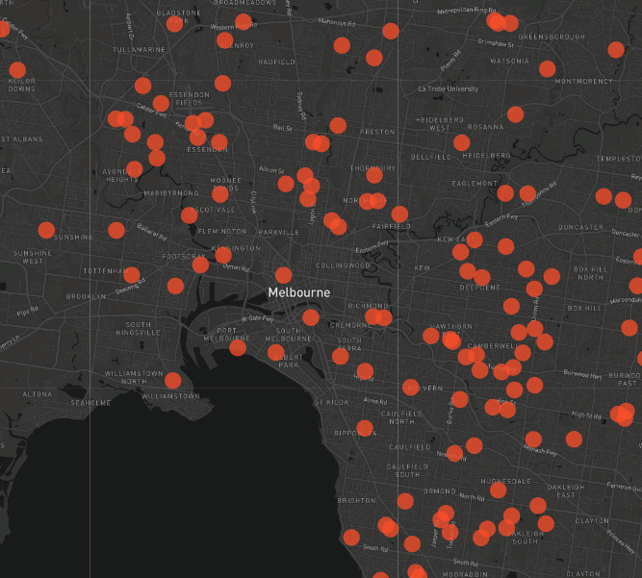
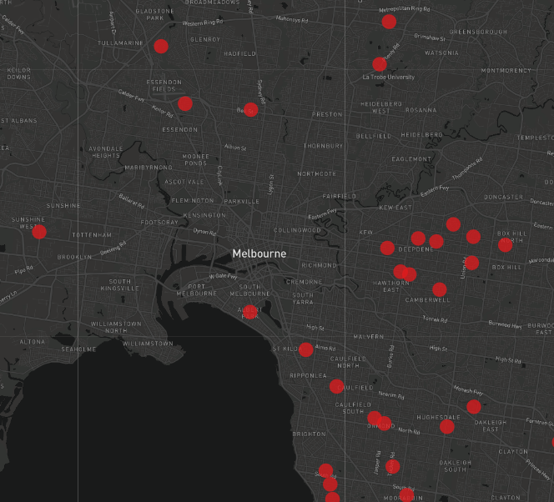
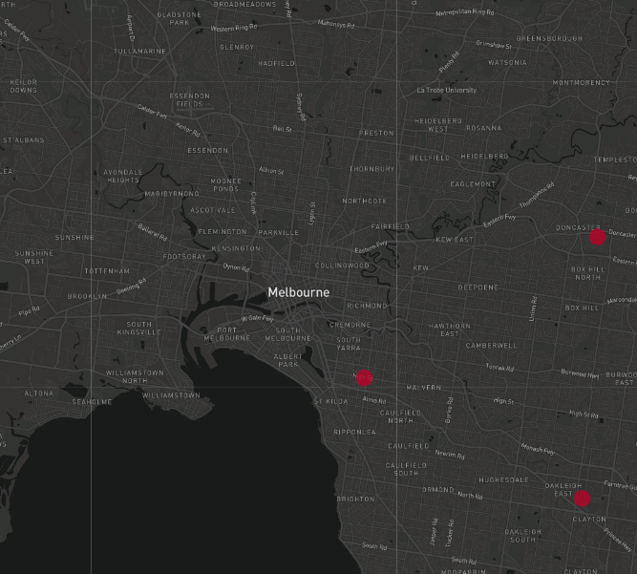
Visualisation 2:
Findings:
1 bedrooms – All bar one was in an inner city suburb.
2 bedrooms – Predominantly inner to middle suburbs. Heaviest concentration 5-15 kms from the CBD.
3 bedrooms – Even concentration in inner, middle and outer suburbs.
Bedroom Numbers in Properties Sold in Melbourne
Findings:
4 bedrooms – Most common in middle to outer suburbs.
5 bedrooms – Virtually none in the inner city suburbs. More in the 40-50km range from the CBD.
6 bedrooms – Rare in this day and age. Two in the outer-middle suburbs, and one in the wealthy inner suburb, Prahran.
1 bedroom
2 bedrooms
3 bedrooms
4 bedrooms
5 bedrooms
6 bedrooms

Slide 14
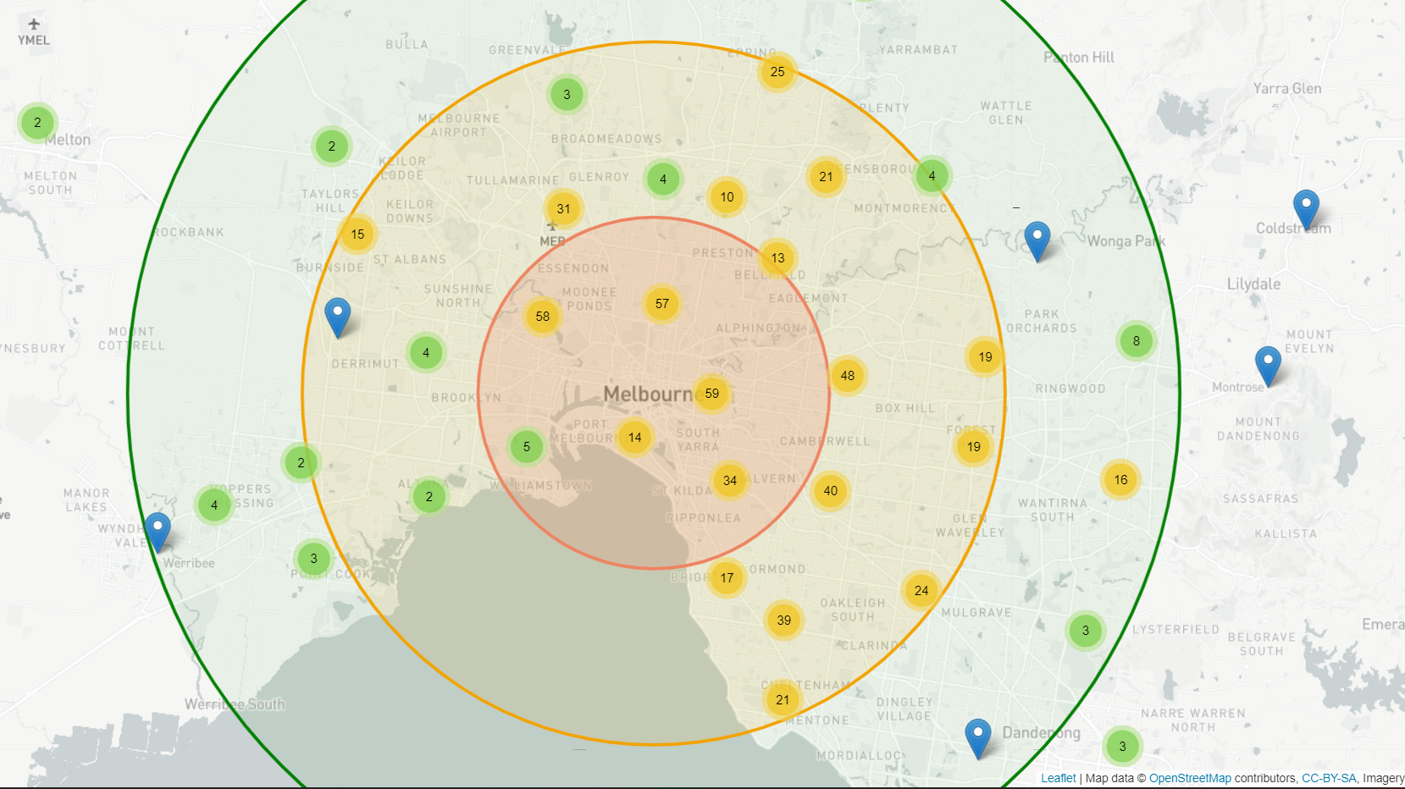
Clustered or Dispersed?
Visualisation 3:
Hypothesis:
There will be a higher number of sales in locations that are closer to the city centre.

Slide 15
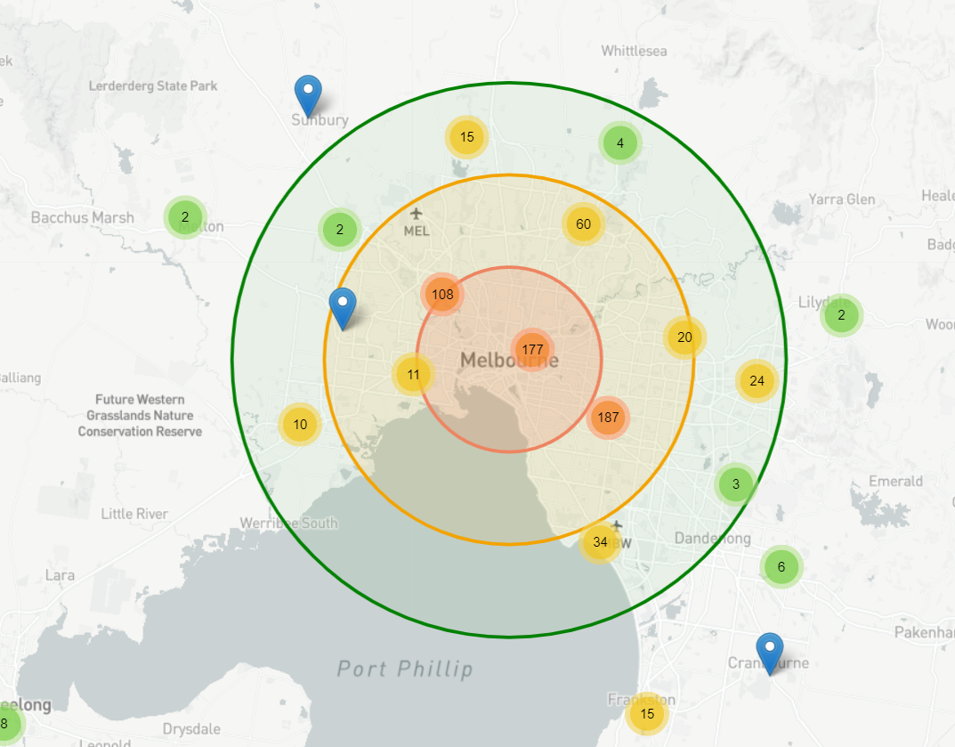
Clustered or Dispersed: Findings
Visualisation 3:
Circa 700 properties sold via auction on the weekend.
41% within approximately 10km of the city radius.
47% within 10-20km city radius.
50% within (north-to-south) eastern regions, 25% in central regions and 25% in western regions.
Findings: The sale of properties via auctions is clustered within 20km city-radius, mainly in the eastern regions.

Slide 16


Visualisation 3: Data Limitations
Bias in reporting sale price:
Reporting the sale price is not mandated.
It is in an agency’s best interest to only report favourable prices.

